Slide 1
Polarized Neutrons
Ross Stewart
Oxford School on Neutron Scattering - 2024

Slide 2
Take-home message
Polarized neutrons can be used to enhance almost any neutron scattering experiment, either by
Separating and providing additional information on the sources of scattering (nuclear, magnetic, incoherent)
Improving the resolution

Slide 3
Outline
Definitions
Neutron spin, magnetic moment, precession
Polarization, flipping ratio, polarizers, flippers
Polarized neutron scattering
Polarized neutrons interaction with matter
Separation of sources of scattering
Neutron spin-echo
Principle of NSE - using the neutron spin as measuring tool

Slide 4
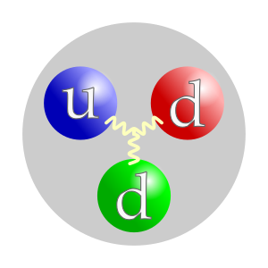
Definitions: Neutron magnetic moment
Boothroyd – Sec 1.2 (p 4)
Particles with spin are experimentally observed to possess a magnetic moment
where,
MHz / T
and
for neutrons
Quarks also have s = ½ quantum number, therefore if the up and down quarks
are antiparallel, the neutron also has s = ½
The magnetic moment calculation is tricky – but can be measured accurately
Often we see the neutron magnetic moment given in terms of nuclear magnetons
where,
What does the minus mean?

Slide 5
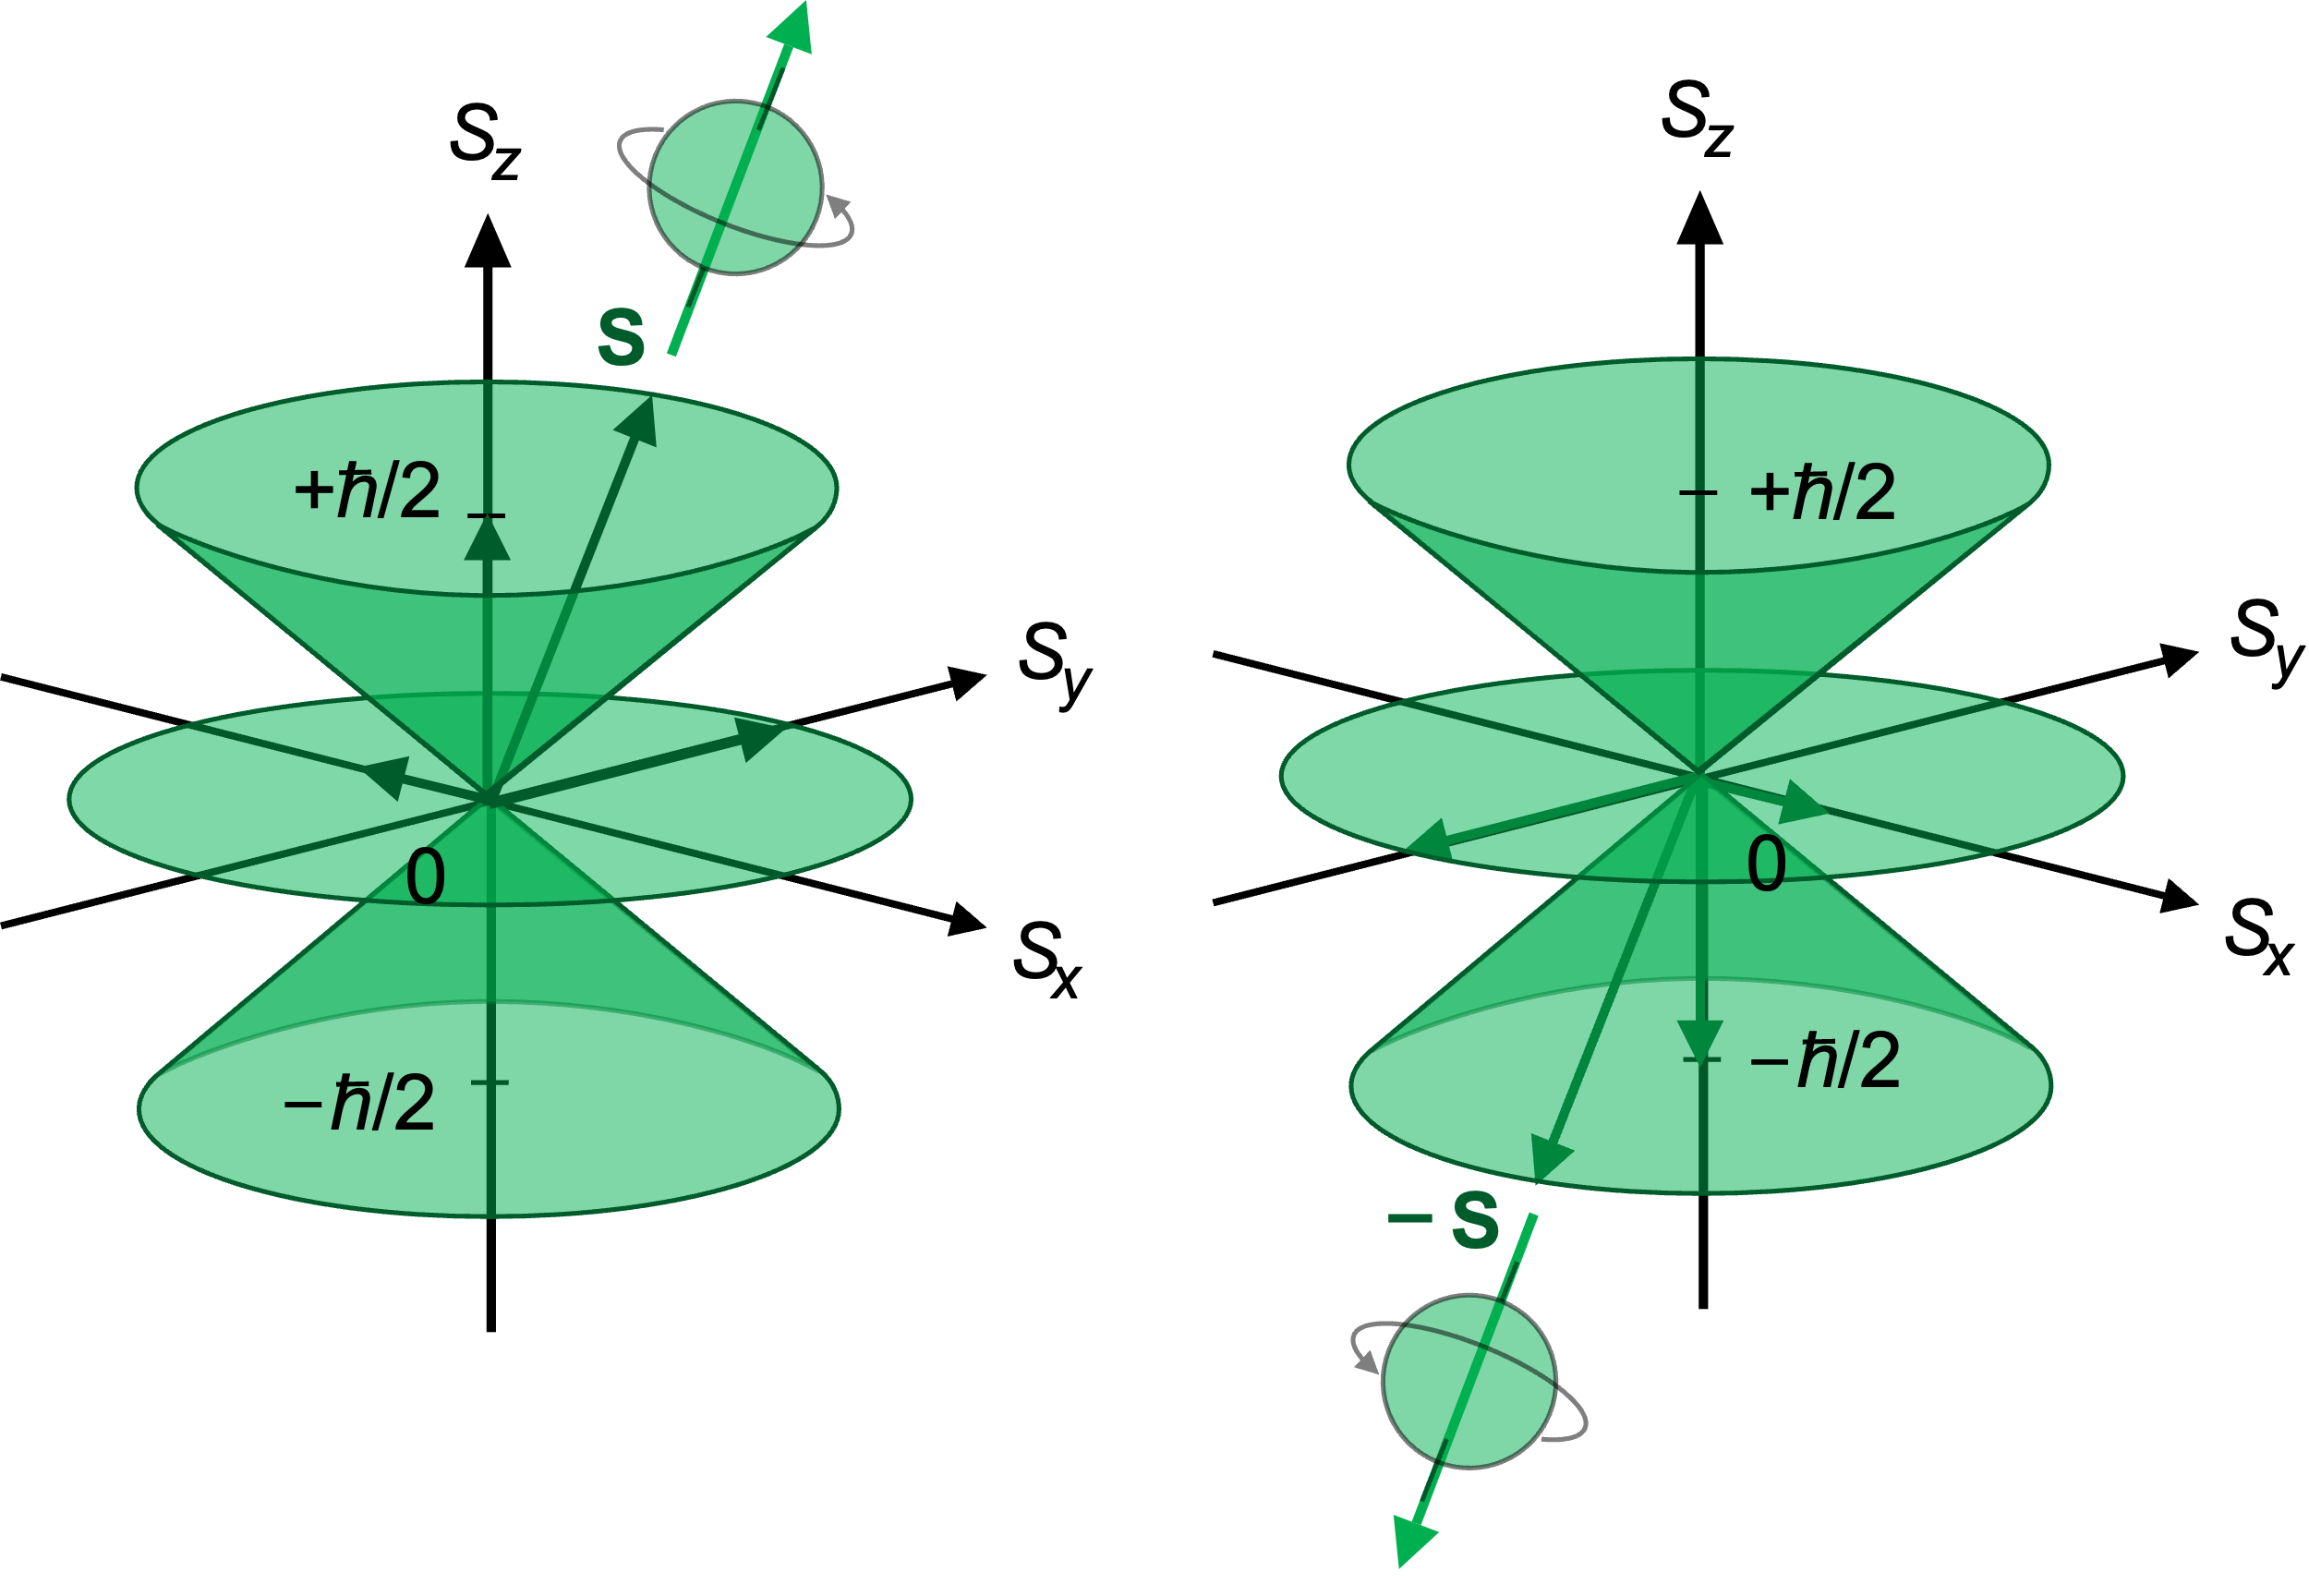
Definitions: Neutron spin-1/2
spin-½ particles
s = ½
m_{s} = -s to +s in integer steps
- only two choices
Describes an intrinsic angular momentum, , that the neutron possesses, with

Slide 6
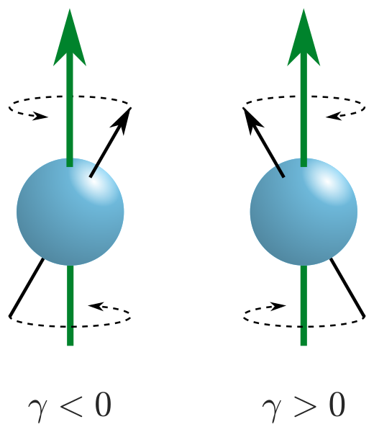
Definitions: Larmor Precession
Magnetic moments in a field experience a torque defined as the rate of change of angular momentum
always in direction perpendicular to both and
therefore, precesses around maintaining the angle
From definition of the cross product

Slide 7
Definitions: Larmor precession frequency
The angular frequency of the moment vector is defined as the rate of change of the rotation angle around the field axis
From the figure, can also be written as the arc-length
divided by component of in the plane of rotation
Rearranging this we get
This is the Larmor precession frequency,
and is known as the gyromagnetic ratio

Slide 8
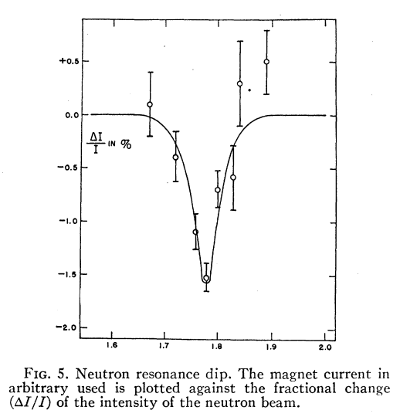
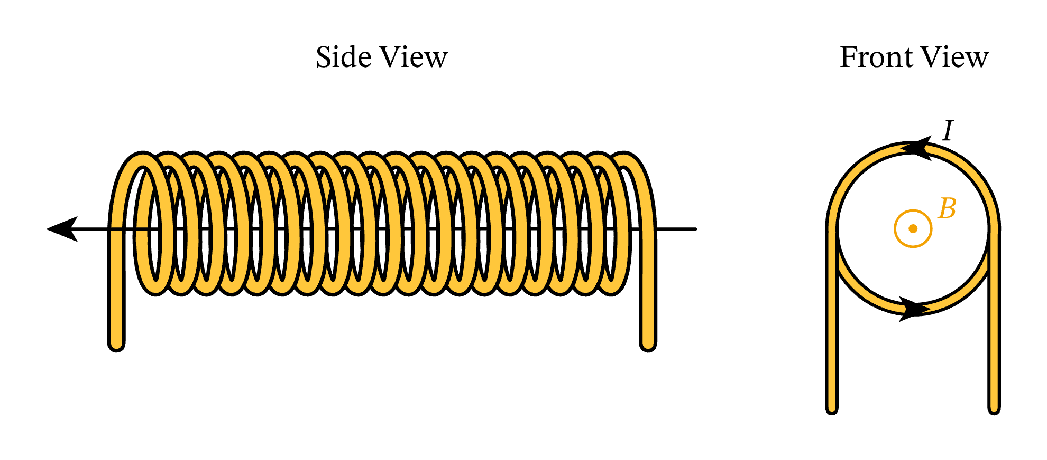
Measuring the neutron magnetic moment: The first ever Neutron Polarization Analysis Experiment
Alvarez and Bloch, Physical Review 57, 111 (1940)
Magnetised iron “Polarizer”
Magnetised iron “Analyser”
“Resonance coil”
neutrons
detector
1 for neutrons perfectly polarized along the field
0 for unpolarized neutrons
-1 for neutrons perfectly polarized against the field

Slide 9
Definitions: Flipping Ratio
Instead of “polarization” of the beam, experimentalists often talk in terms of the neutron flipping ratio
This can refer to a device – polarizer or analyser – but also to the sample under investigation
where, N is the number of neutrons transmitted or scattered.
and
This description of a polarized beam is OK for experiments in which a single quantisation axis is defined: Longitudinal Polarization Analysis

Slide 10
Worked example: Alvarez and Bloch
In the figure on the right, Alvarez and Bloch plot the polarization of their beam as a function of current in their resonance coil – which then gives the resonant
frequency. What was the flipping ratio, and polarizing efficiency of the polarizer
and analyser (P_{p} and P_{a}) assuming they are the same?
The polarization on resonance is,
Therefore,
The measured polarization is just the product of the individual efficiencies

Slide 11
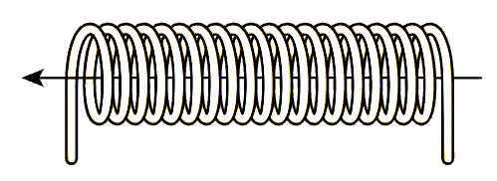
Longitudinal Neutron Polarization Analysis Experiment
Polarizer
B
B
π-flipper
B
B
π-flipper
OFF
B
Analyser
OFF
B

Slide 12
Longitudinal Neutron Polarization Analysis Experiment
Polarizer
B
B
π-flipper
B
B
π-flipper
ON
B
Analyser
OFF
B

Slide 13
Longitudinal Neutron Polarization Analysis Experiment
Polarizer
B
B
π-flipper
B
B
π-flipper
ON
B
Analyser
ON
B

Slide 14
Longitudinal Neutron Polarization Analysis Experiment
Polarizer
B
B
π-flipper
B
B
π-flipper
OFF
B
Analyser
Non-Spin-Flip
ON
B
Spin-Flip

Slide 15
Nuclear Spin-Dependent Scattering
Boothroyd – Sec 4.1.2 (p 100)
Nuclear scattering The scattering length depends on the whether the neutron spin is parallel or antiparallel to the nuclear spin
- neutron/nuclear spins add
- neutron/nuclear spins subtract

Slide 16
Reminder: Magnetic scattering
Boothroyd – Sec 4.2 (p 103)
Magnetic scattering The magnetic scattering is a vector interaction – Since the magnetic field in the sample is divergence-free ( ) after taking the Fourier transform we get,
where,
Neutron probes component of the magnetization perpendicular to Q

Slide 17
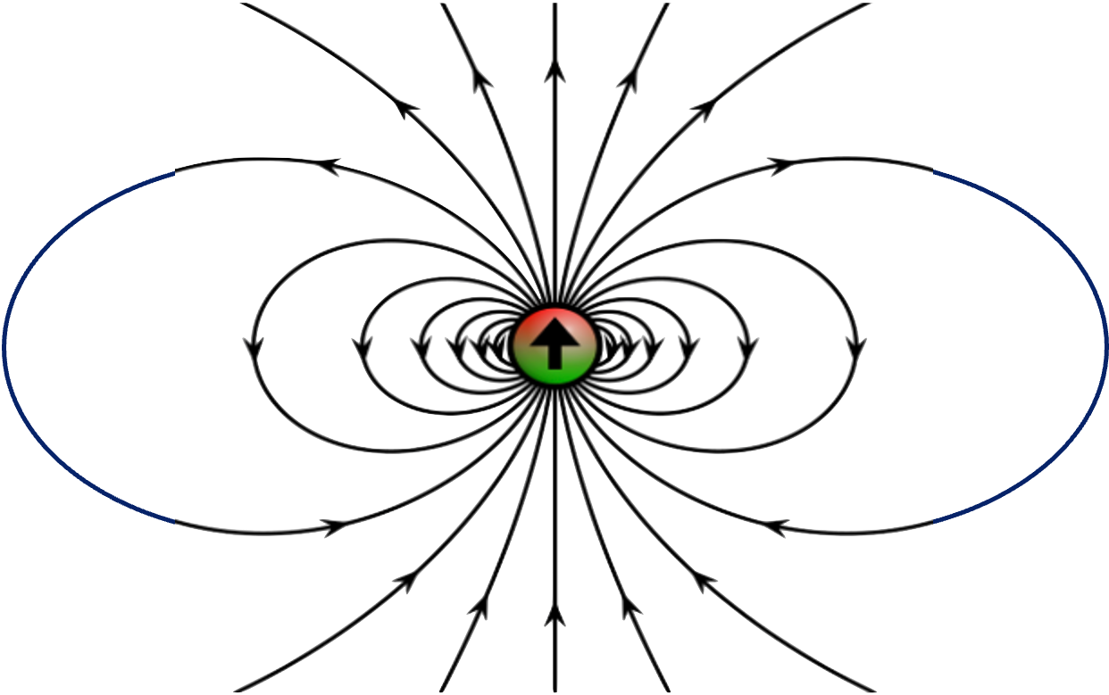
Magnetic Spin-dependent Scattering (classical)
Spin-flip
Non-Spin-Flip
Magnetic scattering has complex spin-dependence There will be a classical torque on the neutron moment if there are components of the field perpendicular to it
if parallel to
No torque – so all scattering is non-spin-flip
if perpendicular to
Neutron spin can precess in the field – spin-flip scattering

Slide 18
Polarized neutron scattering
Moon, Riste and Koehler, Physical Review 181, 920 (1969)
Boothroyd – Sec 4.4 (p 110)
The polarization-dependent scattering cross-sections can be calculated from the following
Moon-Riste-Koehler equations
where,
The z-direction is along the direction of the neutron polarization
I is the nuclear spin quantum number and I_{x} , I_{y} and I_{z} are the components of the nuclear spin angular momentum
, , and are the components of the magnetic field perpendicular to the scattering vector

Slide 19
Coherent (nuclear) Scattering
Boothroyd – Sec 4.5.1 (p 112)
Assuming no magnetism in the sample – we can work out the coherent (see A Boothroyd lectures)
nuclear scattering, just by taking the average of the amplitudes
Now, if the nuclear spins are randomly oriented, then the average over any one component of I is zero. Therefore
All the nuclear coherent scattering appears in the Non-Spin-Flip measurements

Slide 20
Incoherent (nuclear) Scattering
Boothroyd – Sec 4.5.1 (p 112)
Again, assuming no magnetism we can work out the incoherent scattering which (from A Boothroyd’s lectures), is given by the variance in the scattering amplitudes
Applying this to the NSF amplitudes, we get
Again, we assume that the nuclei are randomly oriented
Nuclear isotope incoherent
Nuclear spin incoherent
Note that
, so for isotropic nuclear spins

Slide 21
Incoherent (nuclear) Scattering
Boothroyd – Sec 4.5.1 (p 112)
Again, assuming no magnetism we can work out the incoherent scattering which (from A Boothroyd’s lectures), is given by the variance in the scattering amplitudes
Applying this to the SF amplitudes, we get
So assuming randomly oriented nuclear spins again, we get
which is exactly twice the non-spin-flip spin-incoherent scattering

Slide 22
Non-magnetic polarization analysis
if the scattering is fully coherent/isotope incoherent – then the scattered polarization is preserved
if the scattering is fully spin-incoherent then,

Slide 23
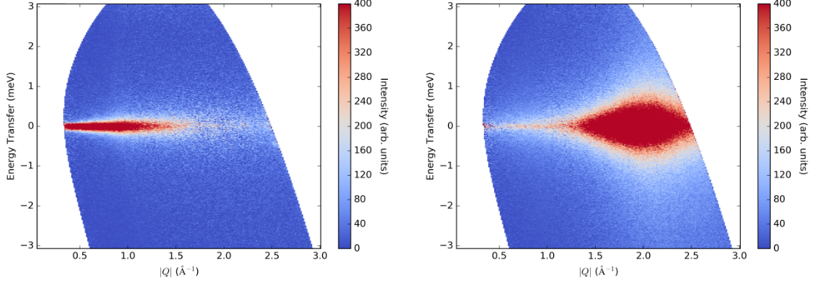
Example 1 – Water (D₂O) at 295 K
Arbe et al., Phys Rev Res 2, 022015 (2020)
Measured on LET at ISIS
Single-particle (incoherent) and structural (coherent) dynamics are separated
 | σ_{coh} (b) | σ_{SI} (b)
D | 5.59 | 2.05
O | 4.23 | ~0

Slide 24
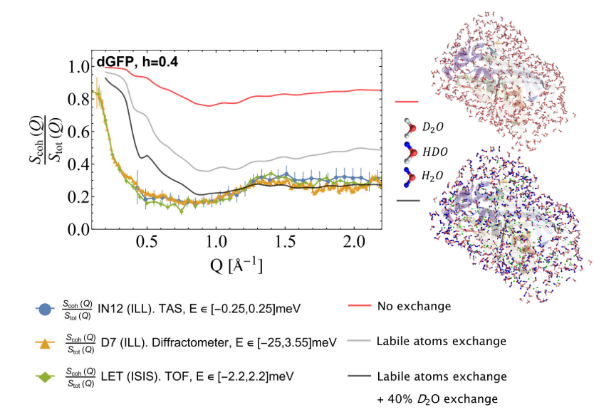
Example 2 – deuterated Green fluorescent protein
Nidriche et al., PRX Life 2, 013005 (2024)
New experiments
challenging assumptions
about “dominant” scattering
on deuteration

Slide 25
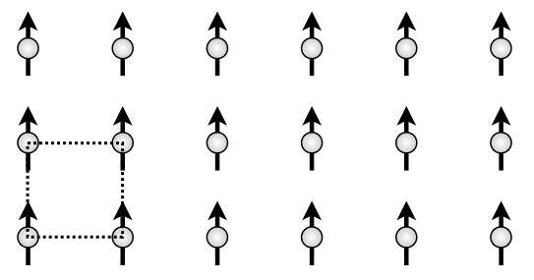
Scattering from Ferromagnets
Boothroyd – Sec 7.3.2 (p 233)
Assuming no spin-incoherent scattering in a ferromagnetic material, and assuming that the magnetization is along the polarization direction – we only need to look at the and amplitudes
M
Writing this in terms of cross-sections and structure factors
Leading to a flipping ratio of
where,

Slide 26
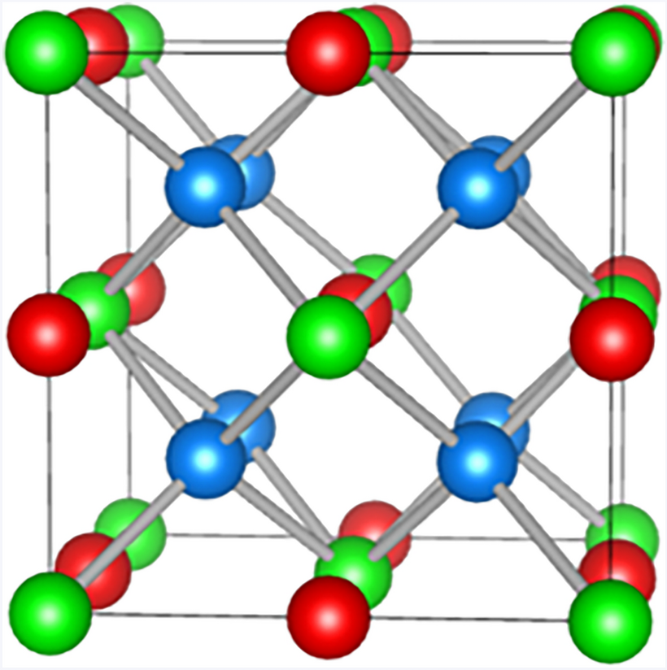
Example 3 – Heusler alloy, Cu₂MnAl
If the (111) Bragg peak from Cu₂MnAl produces a polarization, P = -0.99, what is the ratio of the magnetic and nuclear (111) structure factors?
We can write the ratio of the structure factors, , as a function of the flipping ratio
Cubic ferromagnet
Used as a neutron polarizer
The flipping ratio is,
Therefore
So and don’t have to be that close to get a good polarization

Slide 27
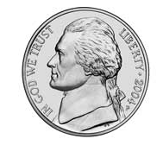
Example 4 – nickel
In nickel, the ratio of the magnetic and nuclear structure factors for the (400)
Bragg peak is . What is the flipping ratio? Compare that with the extra magnetic intensity which would be seen in an unpolarized experiment
The ratio of the magnetic and nuclear intensities in an unpolarized experiment is
So – magnetic structure factors much easier to measure using polarized neutrons (also, much less sensitive to systematic errors)

Slide 28
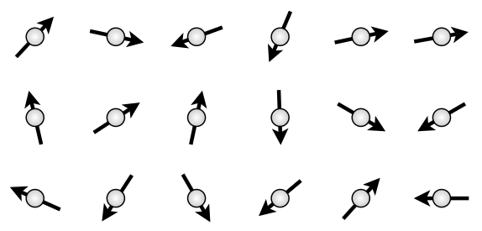
Scattering from disordered magnets
Halpern and Johnson, Phys. Rev. 15, 898 (1939)
Squires – Sec 9.3 (p 179)
Paramagnetic scattering
M = 0
We can therefore write the polarization as
This is easily simplified to give the Halpern-Johnson Equation

Slide 29
“Planar multidetector” – XYZ Polarization Analysis
Paramagnetic scattering

Slide 30
XYZ polarization analysis – paramagnetic scattering
Polarization along x-direction:
Polarization along y-direction:
Polarization along z-direction:

Slide 31
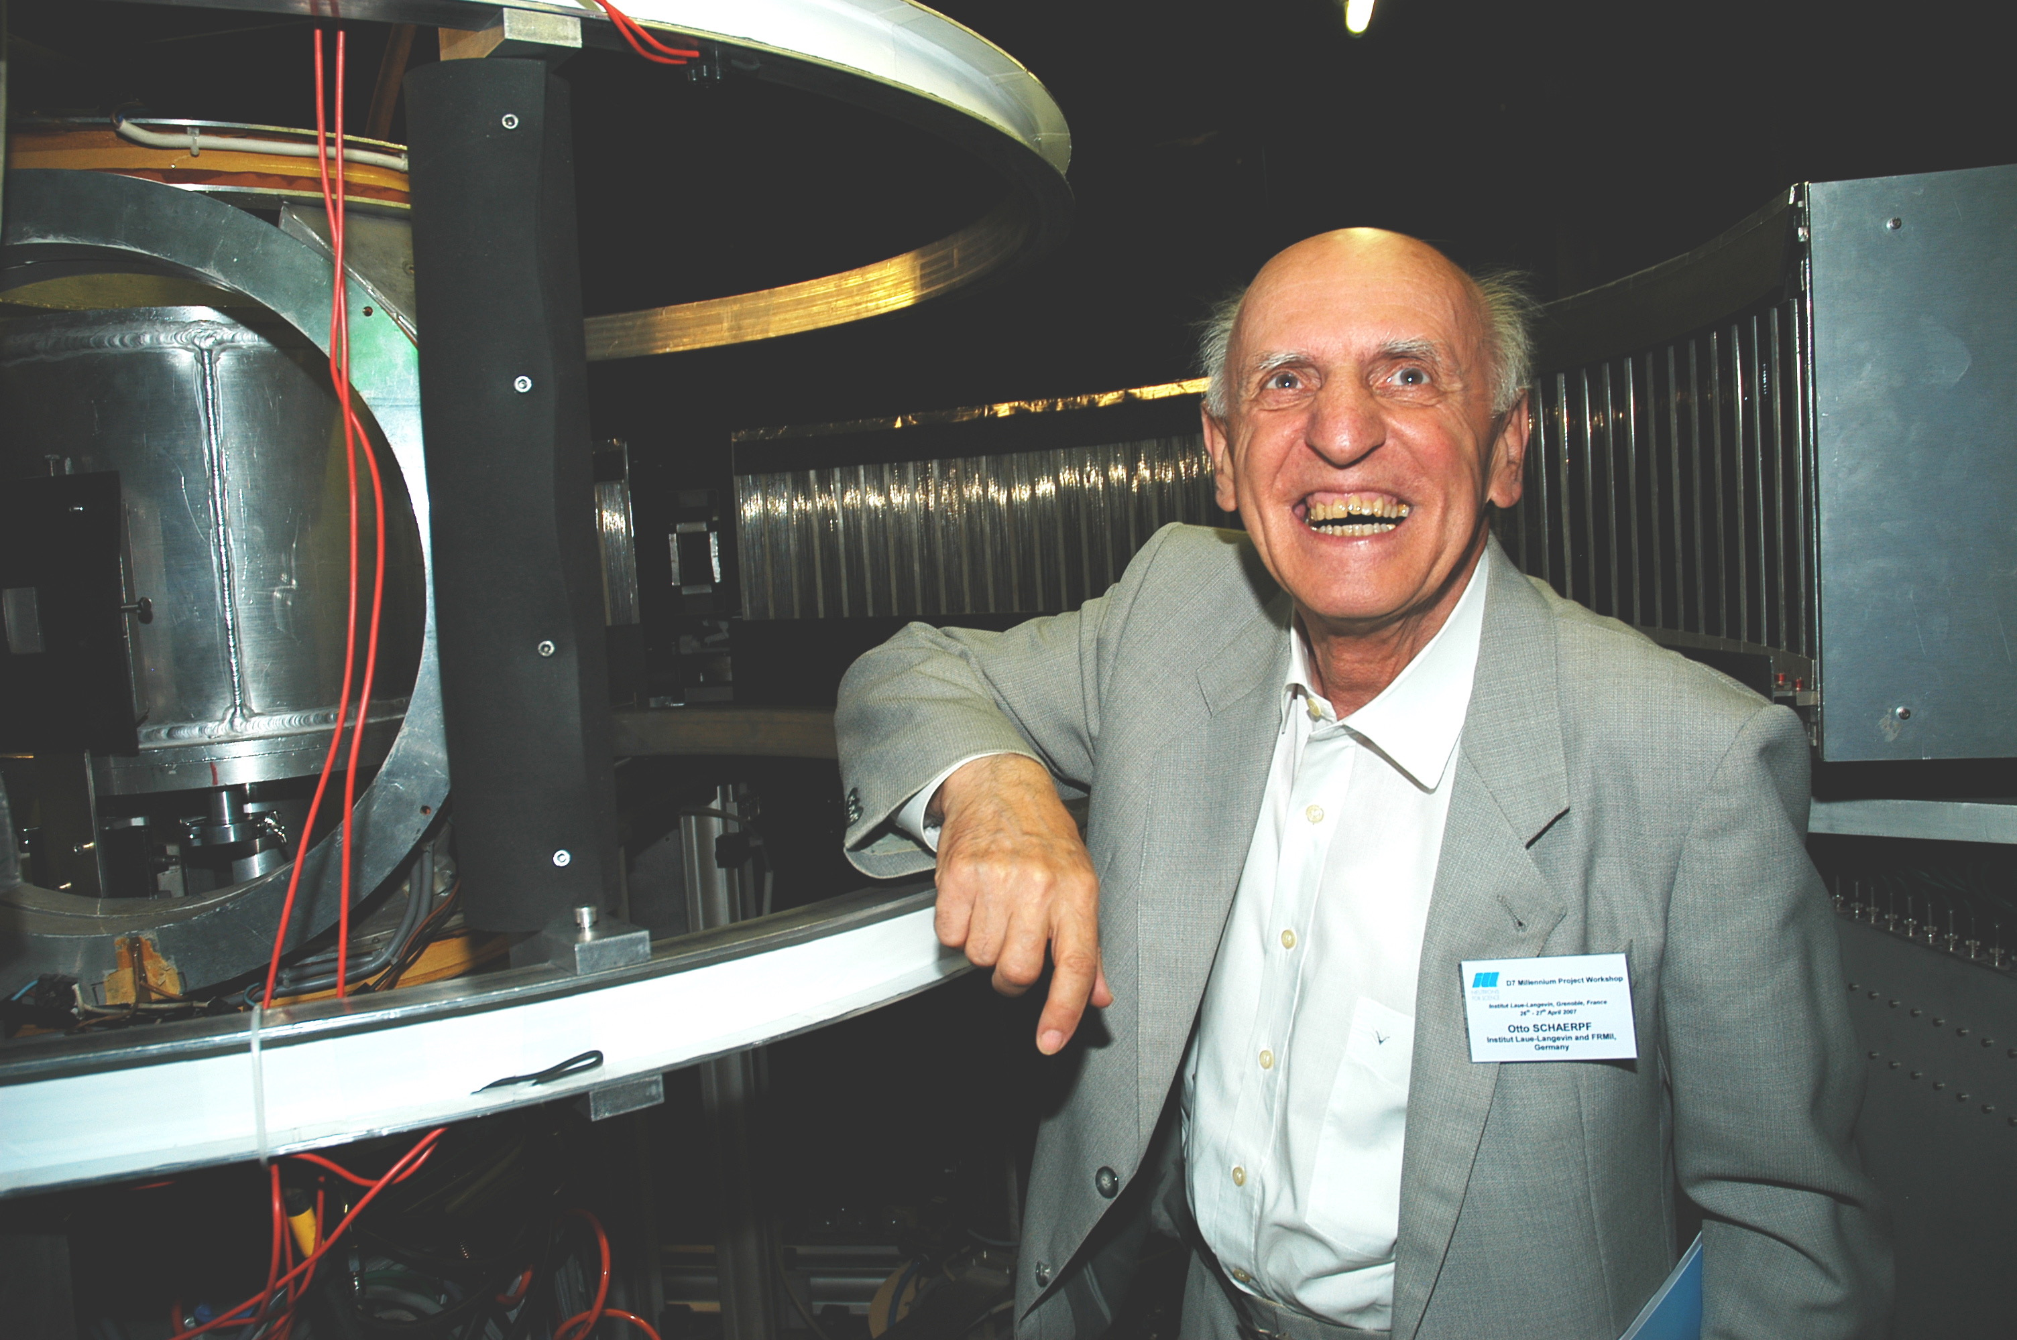
XYZ Polarization analysis – Schärpf Equations
Schärpf and Capellmann, Phys. Stat. Sol. (a) 135 359 (1993)
Boothroyd – Sec 4.6 (p 118)
Otto Schärpf (1929-2019)
6 equations
4 unknowns
known as the Schärpf Angle

Slide 32
XYZ Polarization analysis – Schärpf Equations
Coherent (+II) nuclear scattering
where TNSF and TSF refer to the total non-spin-flip and spin-flip scattering respectively
Magnetic scattering – can be independently calculated in two ways
can take the average of these
Spin-incoherent scattering

Slide 33
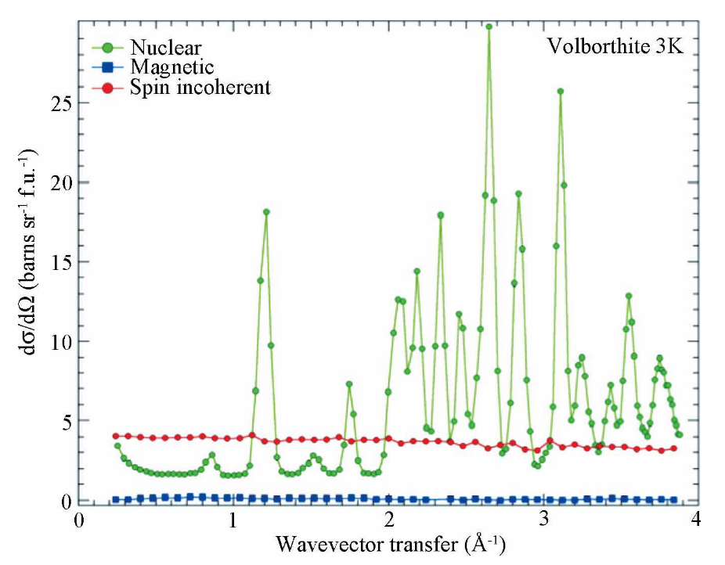
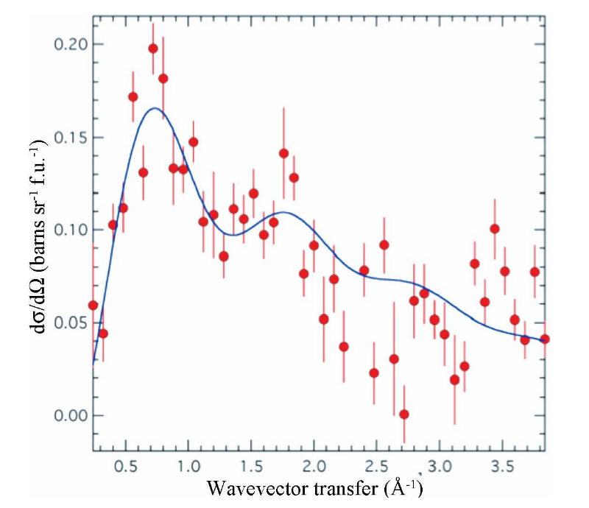
Why is this necessary?
Stewart, et al., J. Appl. Phys 42, 69 (2009)

Slide 34
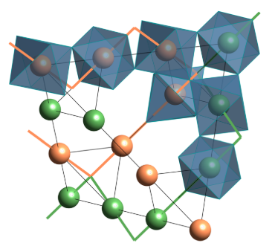
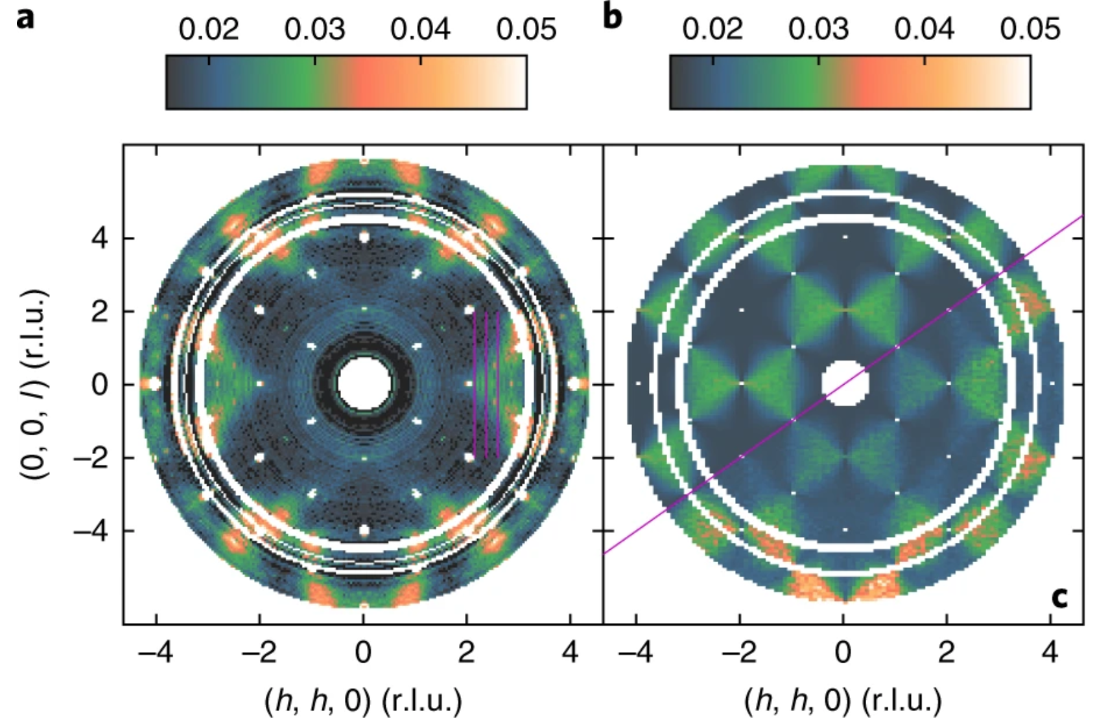
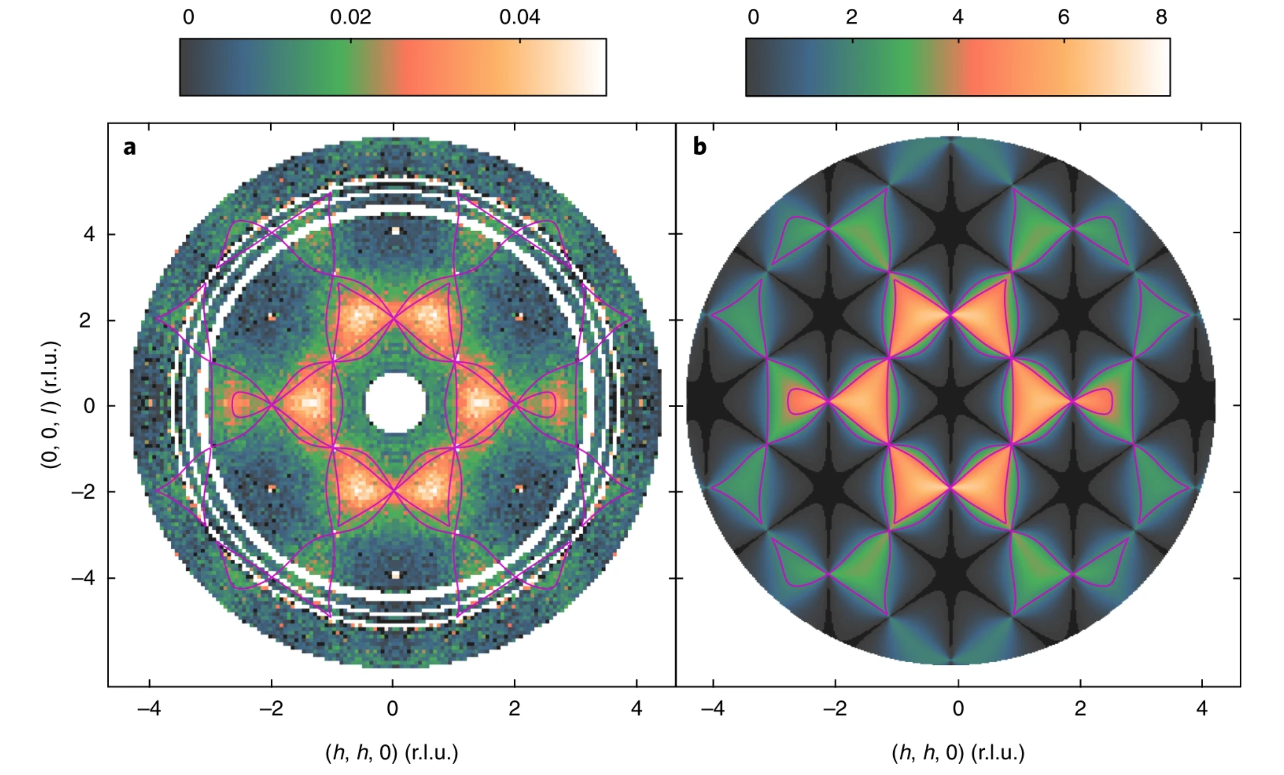
Example 5 – correlated disorder in CsNiCrF₆
Fennell, et al., Nature Phys. 15 (2019) 60-66
Nuclear scattering
Magnetic scattering
Experiment
Calculation
Experiment
Calculation

Slide 35
Reminder – Rules for Polarized Neutron Scattering
The nuclear coherent and isotope incoherent scattering is always NSF
The spin-incoherent scattering is always 1/3 NSF and 2/3 SF
Magnetism: must be in a direction perpendicular to and: - NSF if parallel to - SF if perpendicular to

Slide 36
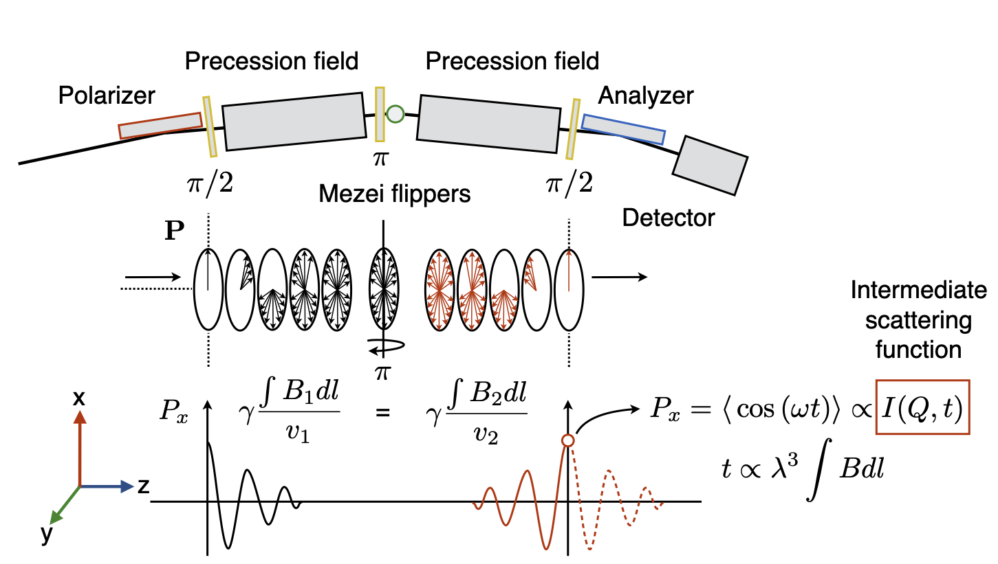
Neutron Spin-Echo
Boothroyd – Sec 5.9 (p 176)
flippers
Number of radians precessed in each arm:
If , and then the neutron spins will all re-align:

Slide 37
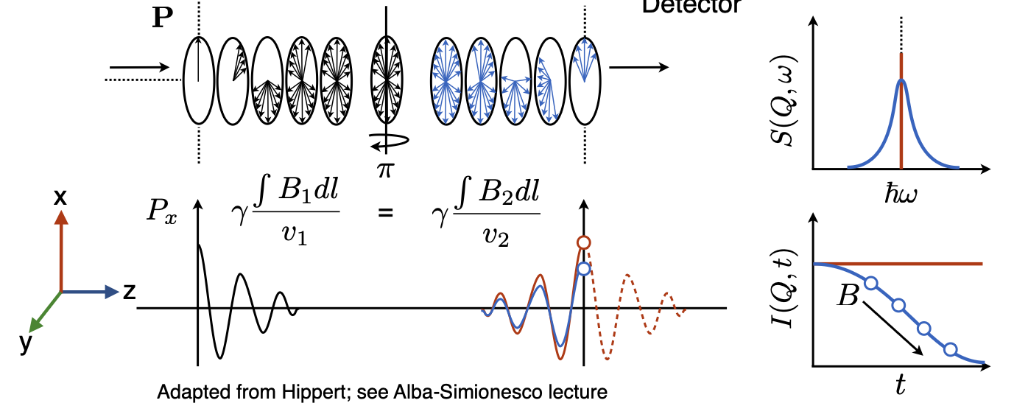
Neutron Spin-Echo
Elastic scattering
(assumes that the sample doesn’t depolarize the beam)
Inelastic scattering

Slide 38
NSE Resolution – Spin-Echo Time
Neutron energy is
In NSE we measure a phase shift
Since we know that and that the phase shift we can identify the Spin-Echo time
Putting in numbers: Tm on WASP at ILL, and nm we find a Spin-Echo time, ns
This is equivalent to GHz, or 0.08 μeV
Much higher energy resolution than on a conventional spectrometer

Slide 39
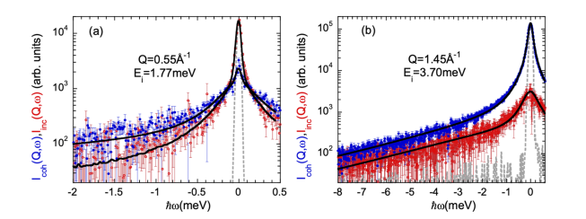
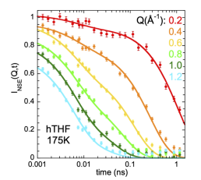
Example 6 – dynamics in van der Waals liquid
Arbe et al., J. Chem. Phys. 158 (2023) 184502
Tetrahydrofuran – THF, C₄H₈O
LET at ISIS
WASP at ILL
Coherent and incoherent scattering in deuterated dTHF
Fit is a model consisting of diffusion (incoherent) and structural relaxation (coherent) – too complicated to disentangle without polarized neutrons – and which requires NSE for the resolution at low Q
Mostly incoherent scattering in protonated pTHF

Slide 40
Take-home message
Polarized neutrons can be used to enhance almost any neutron scattering experiment, either by
Separating and providing additional information on the sources of scattering (nuclear, magnetic, incoherent)
Improving the resolution

